Slide 1

Design an Community Club App
Balakrishna

Slide 2
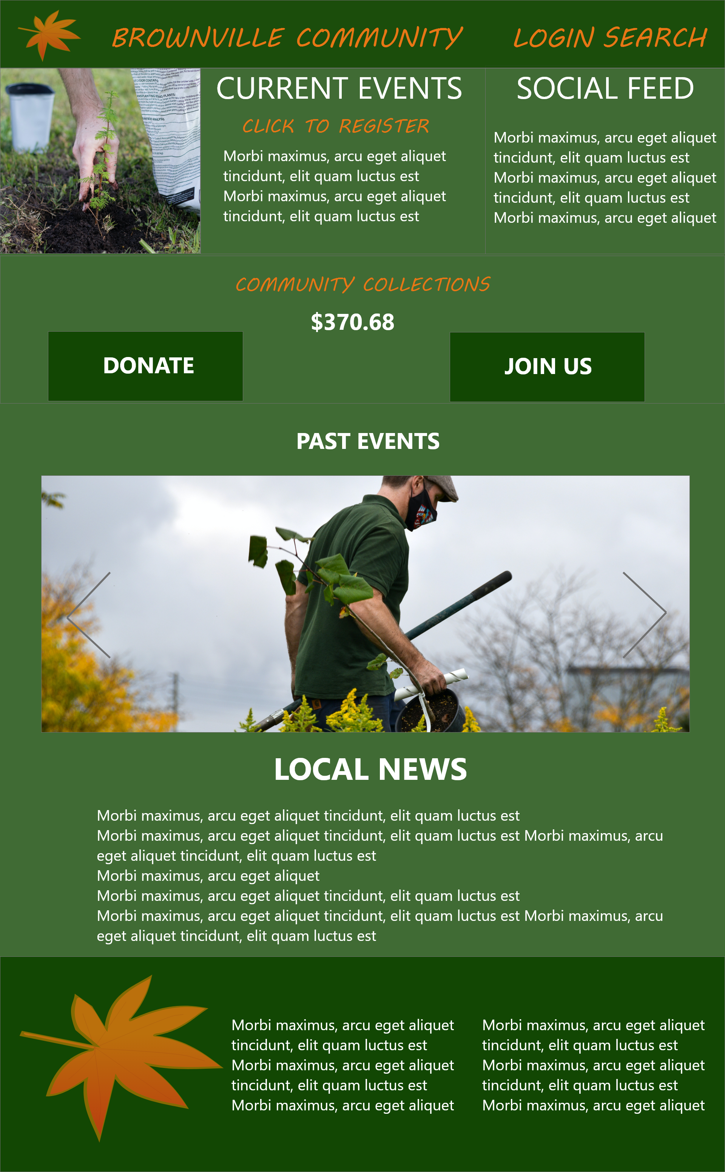
Project overview
The product:
The solution is aimed at catering to local community clubs which organize events for the betterment of the local community
Project duration:
Jan 2022-April 2022

Slide 3
Project overview
The problem:
This is a social good initiative aimed at involvement of citizens in local community activities
The goal:
Design a Mobile App and Responsive Website for a Community Club

Slide 4
Project overview
My role:
User Experience Designer handling the end to end workflow for the project in the Design Phase.
Responsibilities:
User Research and Ideation
Competitive Audit
Wireframing
Low and High Fidelity Design Prototyping
Design Iterations

Slide 5
User research
Personas
Problem statements
User journey maps
Understanding
the user

Slide 6
User research: summary
Based on the user research conducted, we have come up with a design prototype to handle two specific facets of community building – registering for new events and sharing information over older events
We have done a Competitive Audit to understand the strengths and weaknesses of the players in the market and found that the solutions existing in the market doesn’t cater to small village communities. The initial rounds of user research asked for more features to be included and the later rounds asked for simplification of design.

Slide 7
User research: pain points
1
2
3
Lack of Solutions
Community Engagement
Donation Module
Availability of solutions for small local communities
No solutions available to engage the local community after the event is over
Community Apps integrated with Donation Modules are not easily available in the market

Slide 8
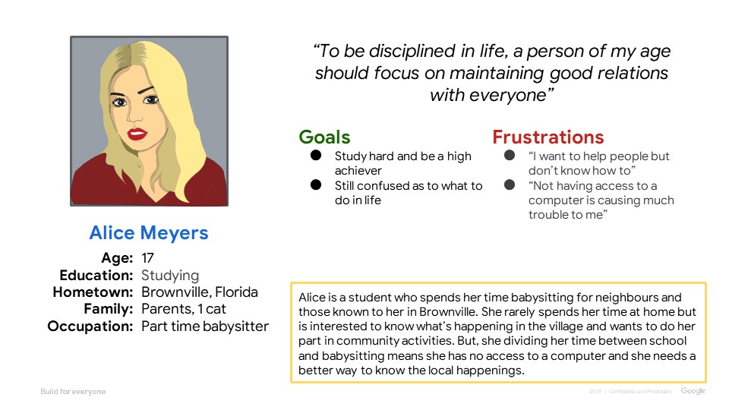
Persona: Alice Meyers
Problem statement:
Alice is a Resident of Brownville who needs a solution to view the upcoming community events because there is no proper way for her to plan for the activities

Slide 9
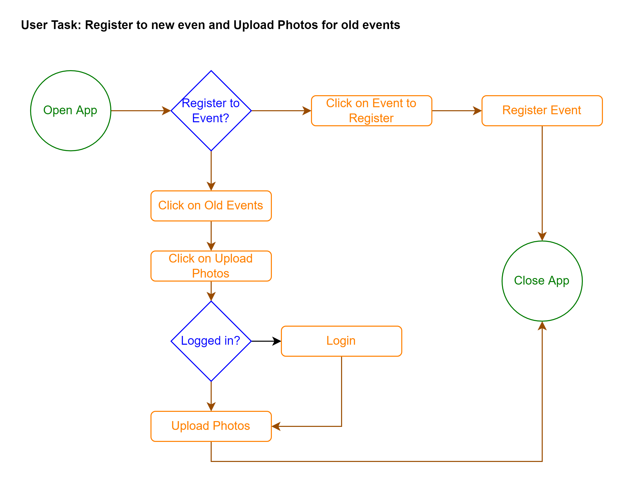
User journey map
The user journey here depicts how register to an event on the App/Website

Slide 10
Paper wireframes
Digital wireframes
Low-fidelity prototype
Usability studies
Starting
the design

Slide 11
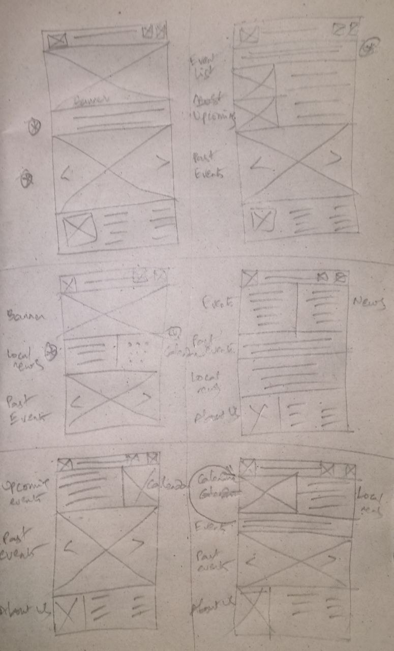
Paper wireframes
Due Diligence was done in designing the wireframes and the most appealing components out of them are considered into the final wireframe along with some changes which are not visible in the original five.
Image of paper wireframes including five different versions of the same screen and one image of the new, refined version

Slide 12
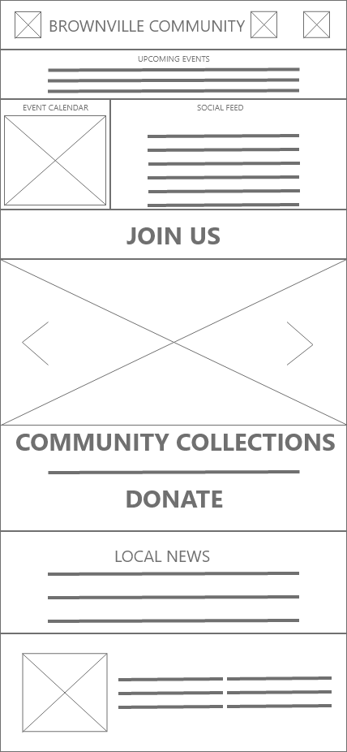
Digital wireframes
The digital wireframe follows the pattern of the paper wireframe created but with some minor changes included to enhance user experience
Insert first wireframe example that demonstrates design thinking aligned with user research

Slide 13
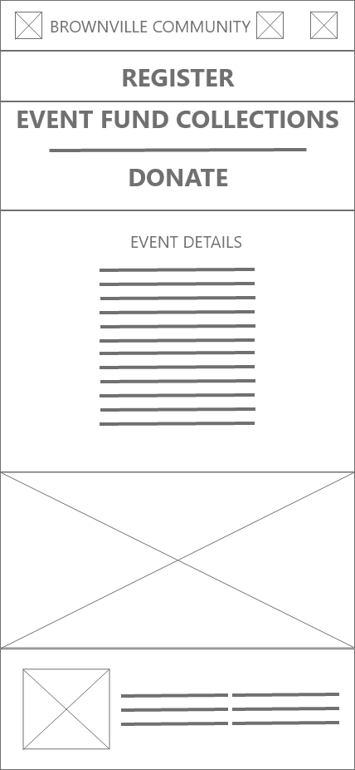
Digital wireframes
This is a follow-up of the first wireframe. This screen will be activated when the user selects an event to register

Slide 14
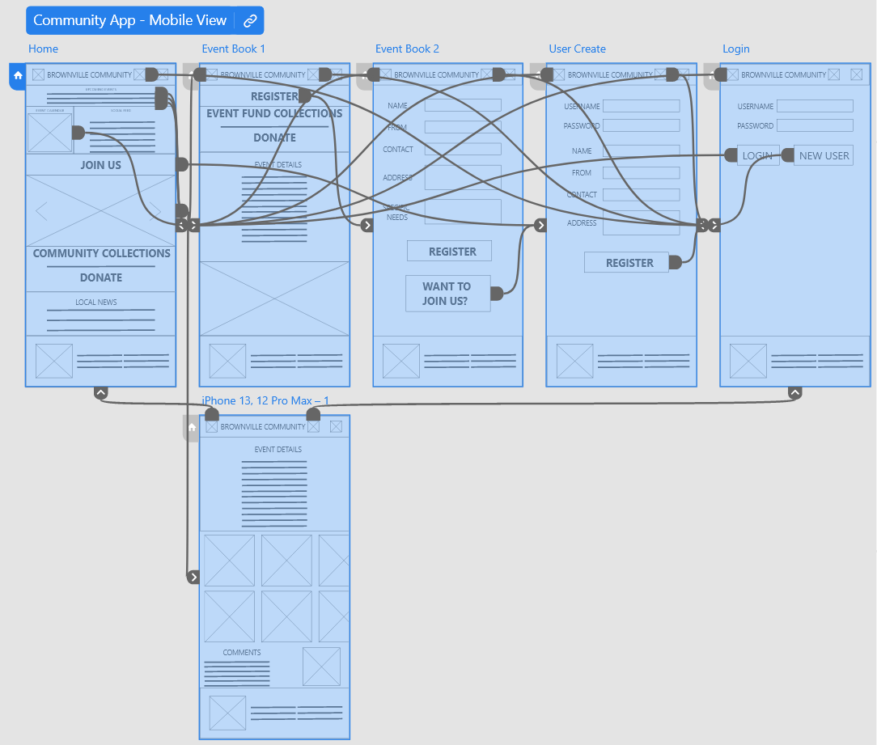
Low-fidelity prototype
The prototype, modelled on the finalized wireframe covers all possible interactions in the app and gives the user a wholesome experience
Screenshot of prototype with connections or prototype GIF

Slide 15
Usability study: parameters
Study type:
Unmoderated usability study
Location:
Brownville, remote
Participants:
4 participants
Length:
30-60 minutes

Slide 16
Usability study: findings
Write a short introduction to the usability studies you conducted and your findings.
Round 1 findings
Round 2 findings
1
Registration need not be mandatory
1
Login button for Register page not needed
2
Display the total funds available
2
Include specific needs for a user
3
Include local news

Slide 17
Refining
the design
Mockups
High-fidelity prototype
Accessibility

Slide 18
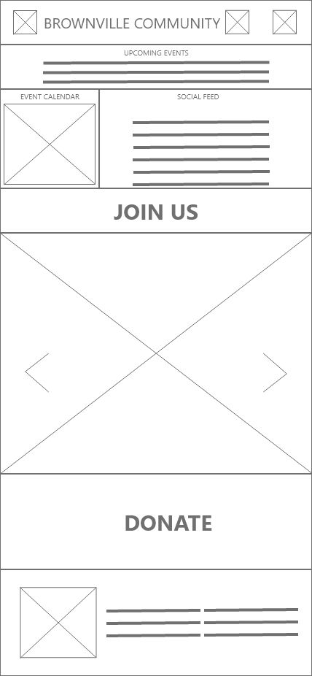
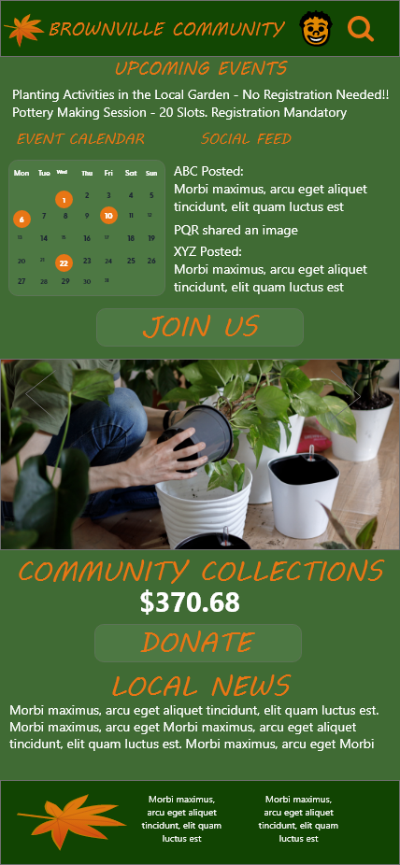
Mockups
Before usability study
After usability study
Early Designs didn’t include the total funds available for the Club and the local news. These were introduced as a part of the first iteration.
Image of selected screen before usability study

Slide 19
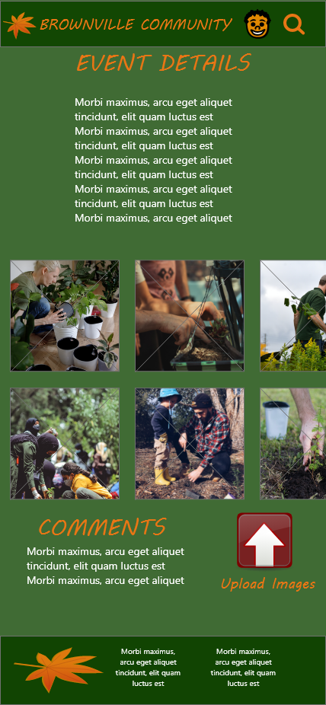
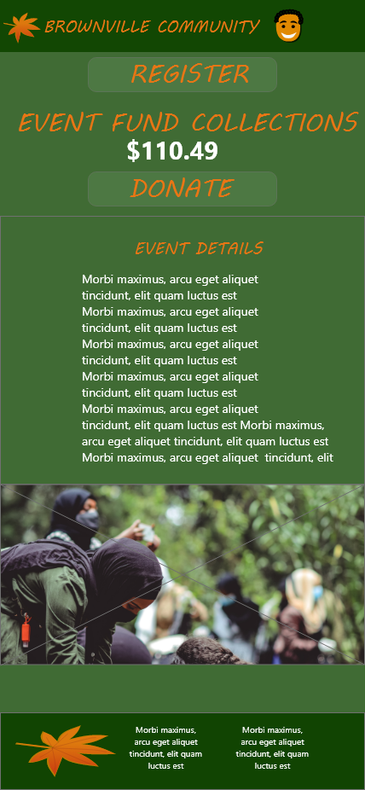
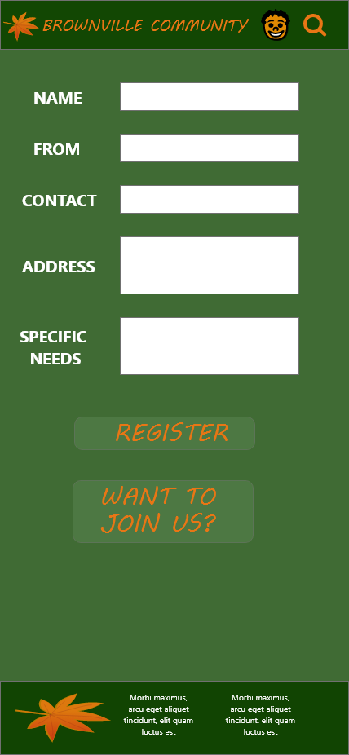
Mockups

Slide 20
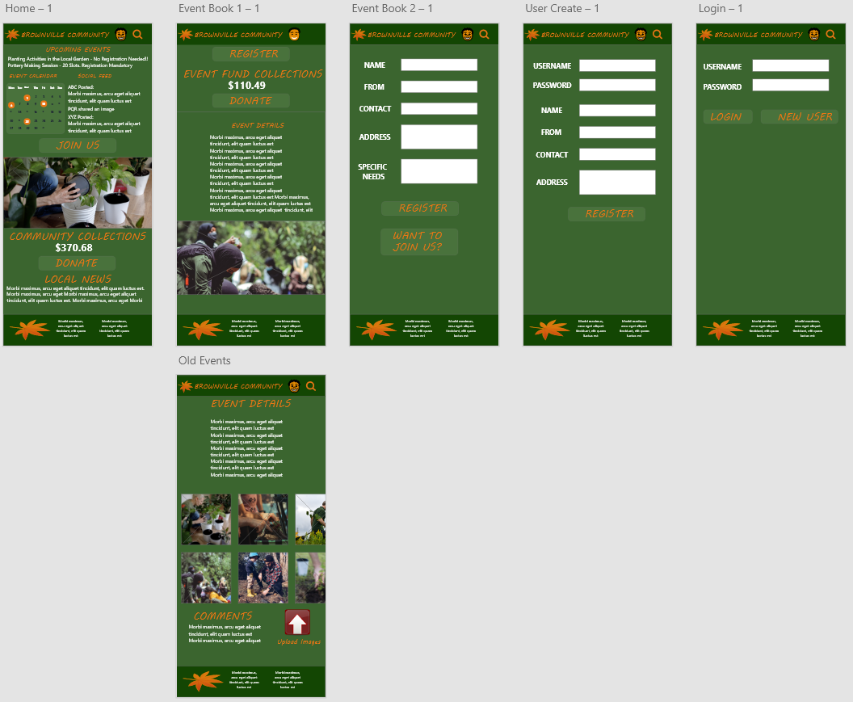
High-fidelity prototype
The final High-fidelity prototype presented makes the user flow more cleaner and more intuitive.
View the Prototype here.
High-fidelity prototype

Slide 21
Accessibility considerations
1
2
3
Because the target users are not technologically up to date, the user flow is built in an intuitive manner
As some users have special needs when participating in the events, a field is added to specify if there are any specific requirements for them
The colour combination is chosen to go well with the logo and is selected to confirm the accessibility standards for the visually challenged

Slide 22
Responsive Design
Information architecture
Responsive design

Slide 23
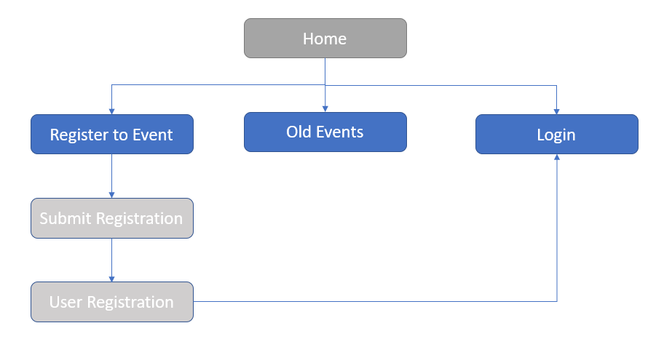
Sitemap
With the app designs completed, I started working on designing the responsive website. I used the Community Club App sitemap to guide the organizational structure of each screen’s design to ensure a cohesive and consistent experience across devices.

Slide 24
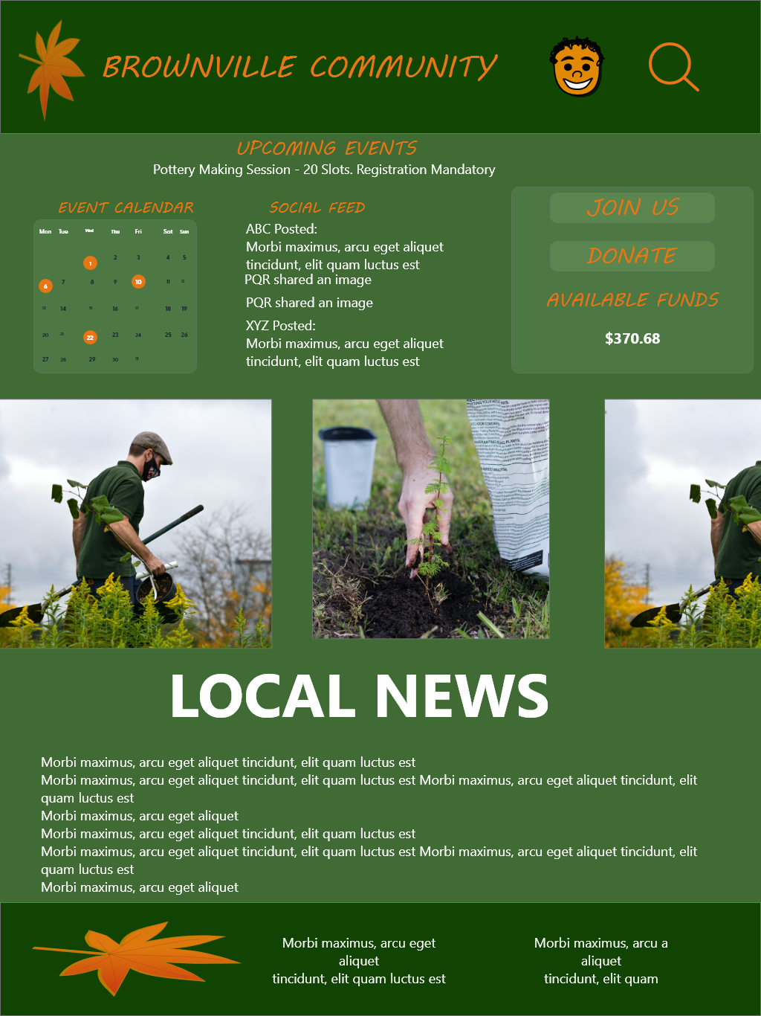
Responsive designs
Mobile website
Tablet
Desktop
The designs for screen size variation included mobile, tablet, and desktop. I optimized the designs to fit specific user needs of each device and screen size.

Slide 25
Going forward
Takeaways
Next steps

Slide 26
Takeaways
Impact:
The users were happy at an integrated solution to cater to the needs of small communities like theirs’.
One quote from peer feedback:
“This is better than what I expected. It is a one stop shop for everything happening in the village”
What I learned:
While designing the app and it’s responsive websites, I learned that the first ideas for the app are only the beginning of the process. Usability studies and peer feedback influenced each iteration of the app’s designs.

Slide 27
Next steps
1
2
3
Conduct another round of usability studies to validate whether the pain points users experienced have been effectively addressed.
Conduct more user research to understand if there are other modules in the app which need to be made optional to make the user flow less cluttered.
Conduct more user research to determine any new areas of need.

Slide 28
Insert a few sentences summarizing the next steps you would take with this project and why. Feel free to organize next steps in a bullet point list.
Let’s connect!
Thank you for your time reviewing my work on the Community Club App! If you’d like to see more or get in touch, my contact information is provided below.
Email: cbk124@gmail.com
Website: https://cbkwgl.webflow.io/

